Slide 1
CAPTONE PROJECT
WALMART SUPER STORE ANALYSIS

Slide 2

Overview / Main Page

Slide 3
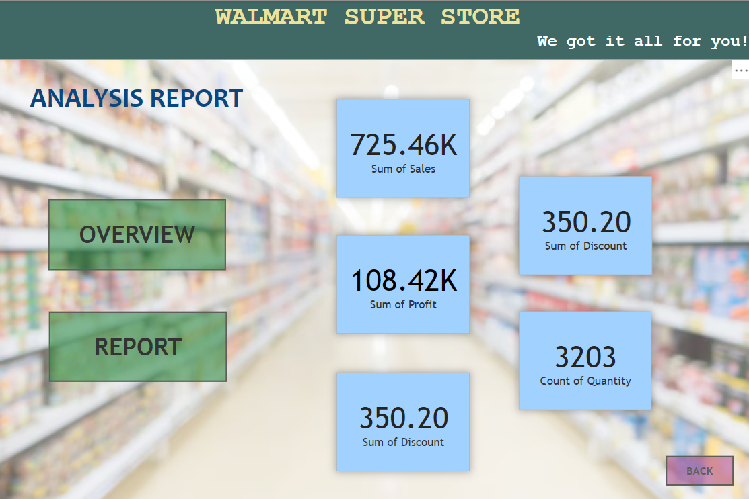
Overview / Main Page -2

Slide 4
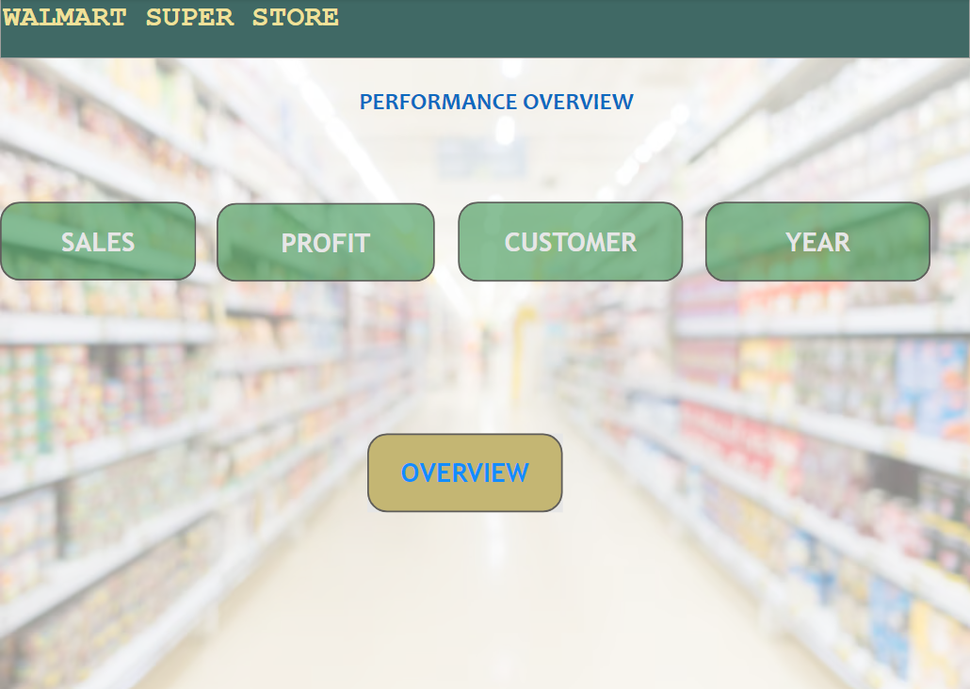
Report Page

Slide 5
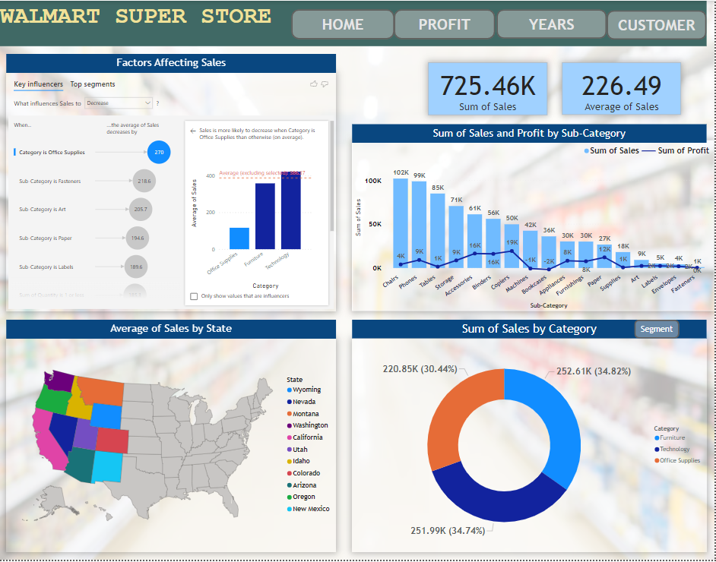
Sales Page

Slide 6
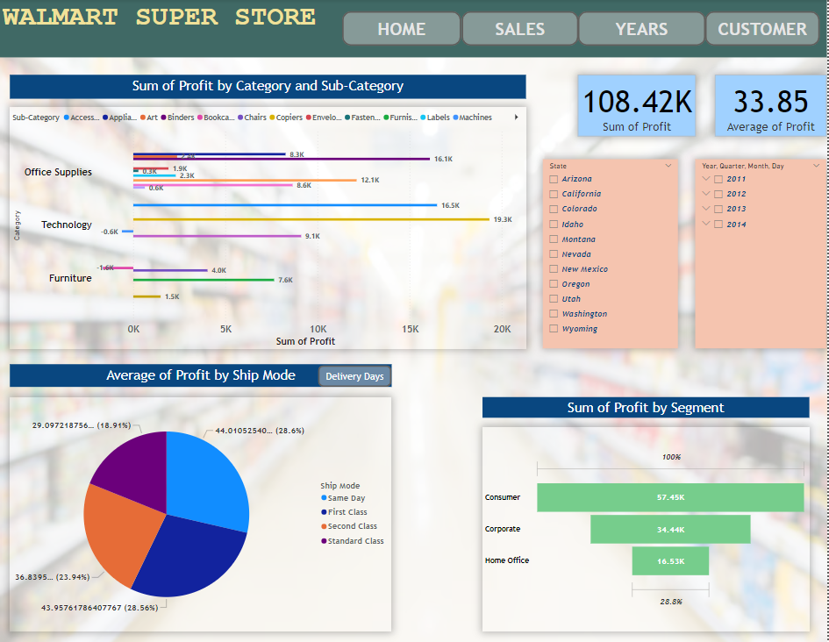
Profit Page

Slide 7
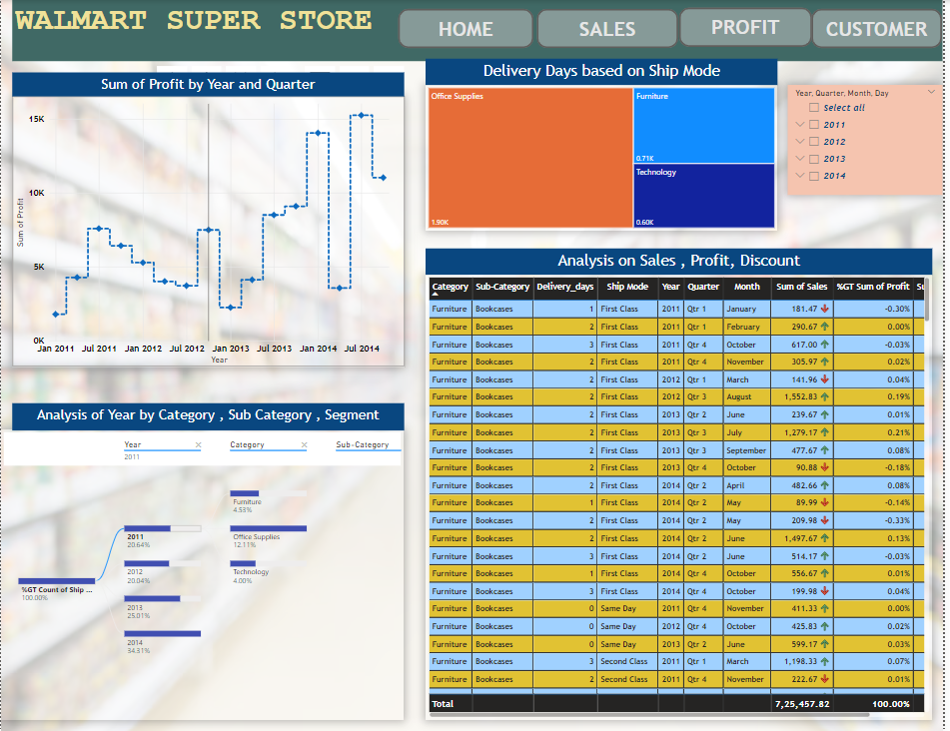
Years Page

Slide 8
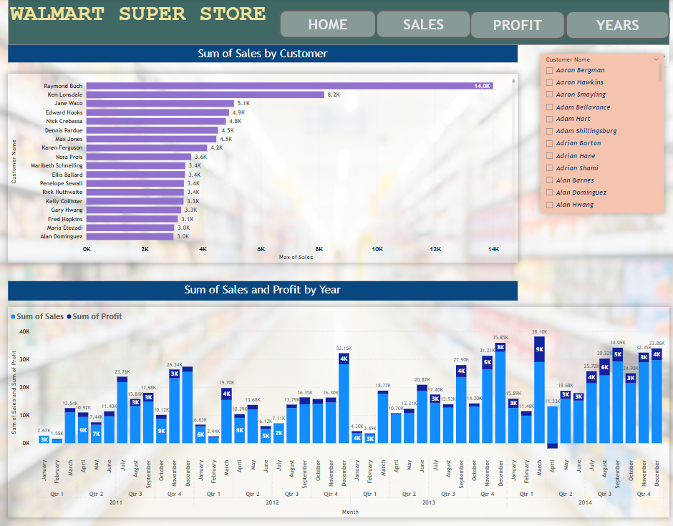
Customer Page

Slide 9
Thank You

